Slide 1

UNIVERSITY OF BUEA • FACULTY OF ENGINEERING AND TECHNOLOGY
CEF 440 — Internet & Mobile Programming
NetInsight
Monitoring Mobile Network Quality of Service & Experience in Cameroon
Final Implementation Presentation
Task 7
Presented to: Dr. Nkemeni Valery
2025/2026
1

Slide 2





CHAPTER ONE · INTRODUCTION
The Problem We Set Out to Solve
Mobile network quality in Cameroon is inconsistent — weak signal, slow speeds and high latency remain common, even after heavy MNO investment.
Our Solution
NetInsight
An Android app (React Native + Expo) that measures QoS metrics and collects QoE feedback, backed by an Express.js API and MongoDB Atlas.
Users can't tell if poor service is their device, location, or the operator
Existing tools measure raw speed but ignore real user experience (QoE)
No localized, continuous monitoring solution exists for Cameroon
React Native + Expo frontend
Express.js REST backend
MongoDB Atlas cloud database
2

Slide 3





CHAPTER ONE · INTRODUCTION
Aim & Objectives
Aim: Design and develop an Android application to monitor and evaluate mobile network QoS and QoE in Cameroon.
01
02
03
04
Study existing network-monitoring approaches
Identify user requirements for quality assessment
Design an intuitive monitoring interface
Build the frontend with React Native & Expo
05
06
07
08
Implement the backend with Express.js
Design a MongoDB Atlas database
Integrate frontend, backend & database
Evaluate the app's monitoring capability
3

Slide 4
CHAPTER ONE · INTRODUCTION
Project Scope
In Scope
Out of Scope
Android app built with React Native & Expo and iOS Version
Collection of selected network performance metrics
Storage of data in MongoDB Atlas
Backend API development with Express.js
Intuitive UI for viewing network information
Direct integration with MNO internal infrastructure
Real-time nationwide network optimisation
Predictive ML models for network analysis
Automatic modification of network performance
4

Slide 5

CHAPTER TWO · LITERATURE REVIEW
Quality of Service vs. Quality of Experience
QoS — measurable network performance
QoE — the user's perceived experience
Latency — round-trip packet delay (ms)
Throughput — data transferred per second (Mbps)
Packet loss — data that fails to arrive
Jitter — variation in packet arrival time
Signal strength — device-to-tower link quality
Page loading speed
Video streaming quality
Voice call clarity
Reliability of connectivity
Frequency of connection drops
Overall satisfaction
NetInsight combines both: objective QoS measurement + subjective QoE feedback.
5

Slide 6
CHAPTER TWO · LITERATURE REVIEW
Existing Apps & the Gap NetInsight Fills
Speedtest
nPerf
OpenSignal
Strength
Fast, popular benchmarking
Strength
Detailed technical metrics
Strength
Coverage mapping
Gap
No continuous monitoring or QoE feedback
Gap
Limited localisation & historical insight
Gap
Little integration of user-reported experience
None combine QoS measurement + QoE feedback + centralised historical storage, tailored to Cameroon — this is NetInsight's gap.
6

Slide 7
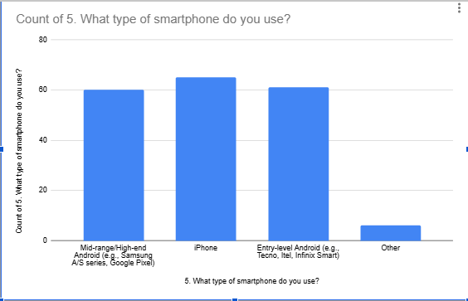



CHAPTER THREE · REQUIREMENT GATHERING
Understanding Our Stakeholders
Survey Findings
Mobile Network Users
Mobile Network Operators
Developers
System Administrator
Techniques used: surveys, brainstorming, reverse engineering, and document analysis.
Surveys
Brainstorming
Reverse Engineering
Document Analysis
7

Slide 8

CHAPTER FOUR · REQUIREMENT ANALYSIS
Functional & Non-Functional Requirements
Functional
Non-Functional
Measure download / upload speed & latency
Display current network & signal information
Store and retrieve historical test results
Validate & sync data via RESTful APIs
Present dashboards & prompt user feedback
Performance — fast responses, low delay
Reliability — consistent, available data
Security — secure auth & communication
Usability — simple, consistent navigation
Maintainability & Scalability — modular design
8

Slide 9
CHAPTER FOUR · REQUIREMENT ANALYSIS
Prioritising with MoSCoW
Must Have
Should Have
Could Have
Won't Have
Minimal data consumption
Minimal battery impact
Privacy & approximate location
Reliability in 'no signal' scenarios
Improved network statistics
Better visualisation of history
Enhanced error handling
Dark mode
Push notifications
Exporting reports
Interactive charts
Location comparison
AI network prediction
Direct MNO integration
Auto network optimisation
Offline sync
Map coverage
9

Slide 10
CHAPTER FIVE · SYSTEM DESIGN
Three-Tier System Architecture
Presentation Layer
React Native + Expo Android app — the graphical interface users interact with
Application Layer
Express.js backend — business logic, validation, and REST API endpoints
Data Layer
MongoDB Atlas — cloud NoSQL database storing metrics & feedback
All three layers communicate via RESTful APIs (HTTPS), keeping responsibilities cleanly separated.
10

Slide 11
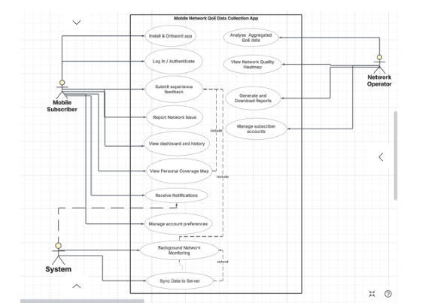

CHAPTER FIVE · SYSTEM DESIGN
Modelling System Behaviour
The design phase modelled NetInsight through Context, DFD, Use Case, Sequence, Class and Deployment diagrams.
Use Case Diagram
Context Diagram
System boundary & external actors
Data Flow Diagrams
How data moves through the app
Use Case Diagram
User interactions, shown right
Class & Deployment Diagrams
Structure & hosting
11

Slide 12
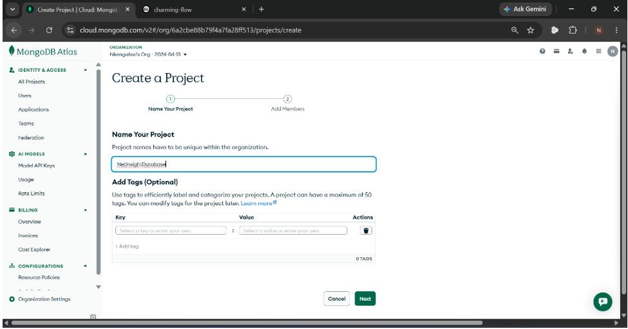
CHAPTER SEVEN · DATABASE DESIGN
MongoDB Atlas & Core Collections
Mongoose schemas enforce validation; Express.js exposes REST endpoints (GET/POST/PUT/DELETE) that connect the frontend to these collections.
Network Metric
Device ID
Timestamp
Connection type
Download / upload speed
Mongo Atlas Live collections
User Feedback
Experience
Area of feedback
Description
Rating
12

Slide 13
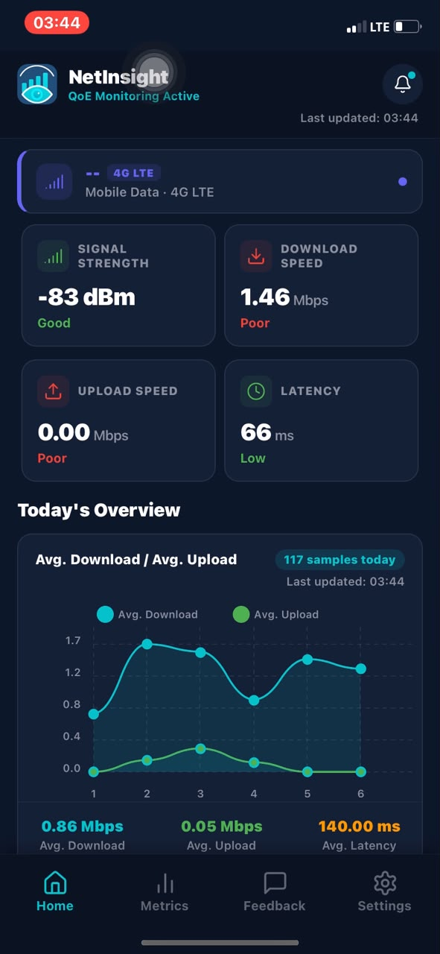
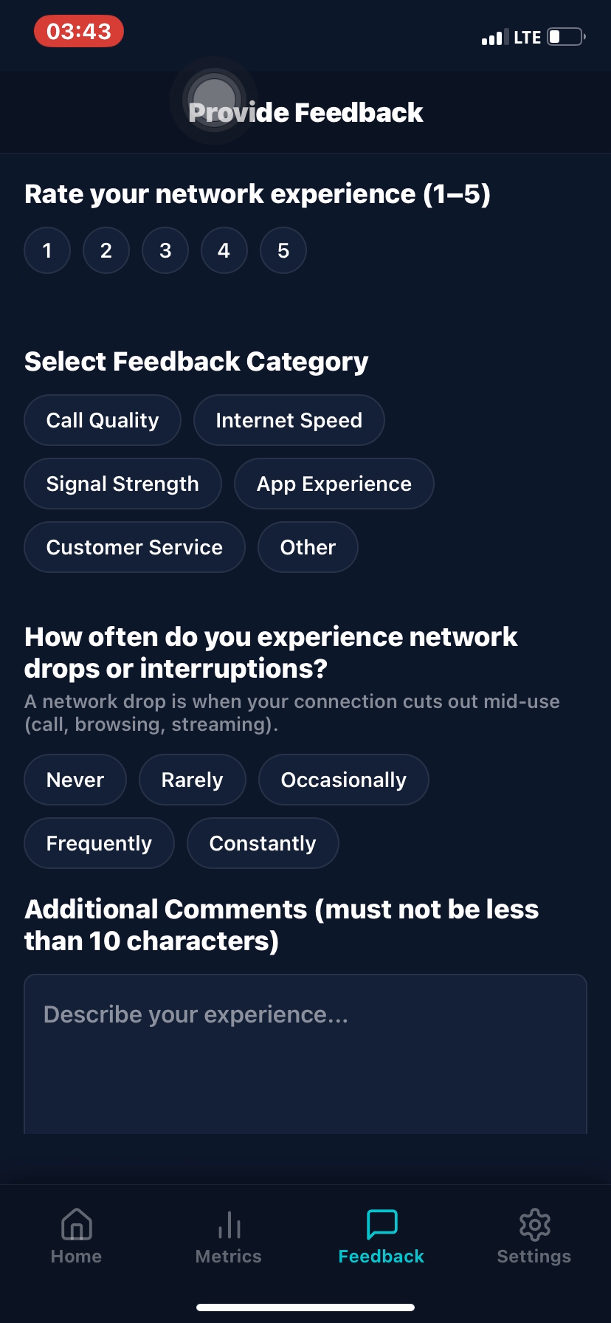
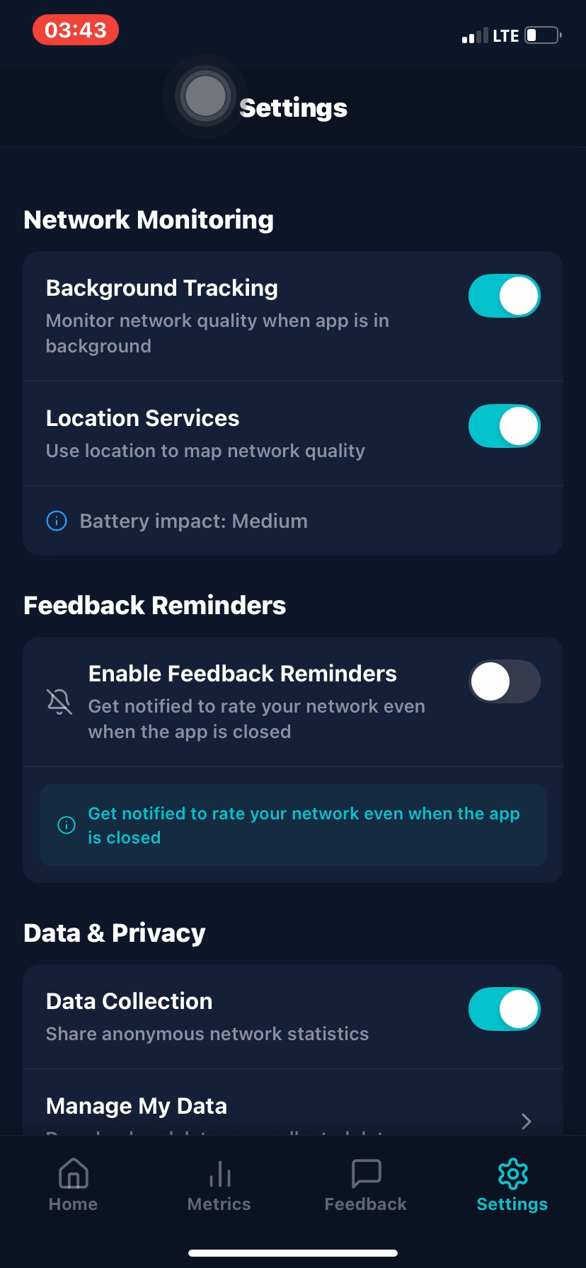
CHAPTER SIX · UI/UX DESIGN
From Figma to a Working App
NetInsight — Network + Insight
Primary blue — trust, reliability & technology
White / light-grey — clean readability
Modern sans-serif typography throughout
Designed in Figma before implementation
HomeScreen
Feedback Screen
Settings Screen
13

Slide 14

CHAPTER EIGHT · TESTING
Verifying the Application Works
Unit Testing
→
Integration Testing
→
System Testing
→
User Validation
Individual components tested independently
Communication between modules verified
Full application tested as one integrated system
Real interaction confirms usability & correctness
Test Environment
Android device / emulator · Expo runtime · Node.js · Express.js server · MongoDB Atlas · stable internet connection
14

Slide 15


CONCLUSION
What We Achieved & What's Next
Achievements
Future Work
Fully functional React Native + Expo Android app
Express.js REST API integrated with MongoDB Atlas
QoS metrics measured alongside QoE feedback
Requirements traced from gathering to testing
Location-based operator comparison
AI-based network prediction: forecast poor-coverage times/areas from historical data
Push notifications — alert users to sudden network degradation
15

